Slide 1
http://www.vidyanidhi.com/
ketkiacharya.net@gmail.com
Ketki Acharya
From: SM VITA ATC of CDAC
9769201036
Ketkiacharya.net@gmail.com

Slide 2
String
String is reference type data
String is also derived from System.Object, ie parent of string class is Object
String is immutable ie. You can not manipulate original string. To modify original string you have to use StringBuilder Class.
In String class == operator is overloaded ie it will check value
String a=“DAC”;
String b=“DAC”
a==b results into true
Equals method generally check reference but in string class it checks value because Equals method is overridden.
GetHashCode is also overridden in string class[It is rule when ever you override equals you must override GethasCode]
ToString method of parent class is overridden in string class.
String is sealed class ie. You can not sub class it.
You can create a object of string class.
Literal string resides in String pool.
Where string pool resides ? It is located on heap.

Slide 3
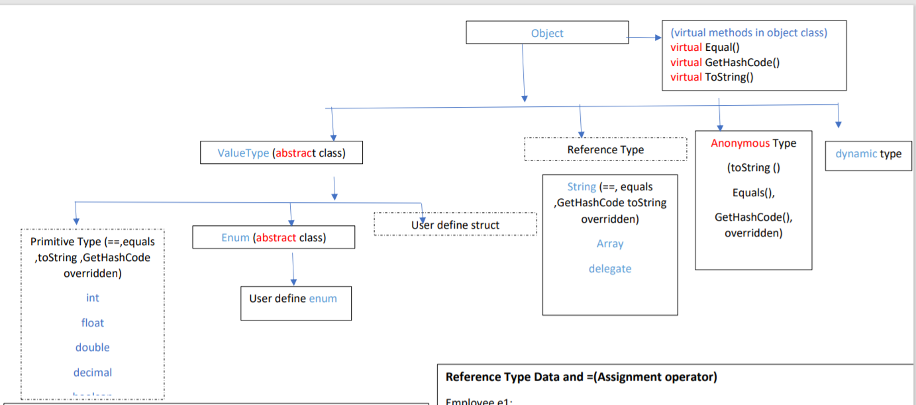
var

Slide 4
String with ==, equal ,GetHashCode & ToString
String pool does not have duplicate value.
== checks value
ReferenceEquals is static method which will check reference ie arrow .that is both variable pointing to same memory block
Equals also check reference but in string class it is overridden so it is checking value.
GetHashCode is also overridden in string class.
ToString method is overridden in string class so it is printing value. In our code last line implicitly calling toString method.
using System;
namespace FunWithStrings
{
class Program
{
static void Main(string[] args)
{
string a, b;
//hardcode string goes in a string pool
a = "Hello";
b = "Hello";
Console.WriteLine(a==b);//true
Console.WriteLine(Object.Equals(a, b));//true
Console.WriteLine(Object.ReferenceEquals(a, b));//true
Console.WriteLine(a.ToString());//Hello
Console.WriteLine(a);//Hello
Console.WriteLine(a.GetHashCode());//-694847
Console.WriteLine(b.GetHashCode() );//-694847
}
}
}
a
String Pool
“Hello”
b
-694847

Slide 5
Lets prove .Equals and GethashCode overriden
using System;
namespace FunWithStrings
{
class Program
{
static void Main(string[] args)
{
string a, b;
//hardcode string goes in a string pool
a = "hello";
b = a.ToLower ();//convert string to lower case
Console.WriteLine(a==b);//true
Console.WriteLine(Object.Equals(a, b));//true
Console.WriteLine(Object.ReferenceEquals(a, b));//false
Console.WriteLine(a.ToString());//hello
Console.WriteLine(a.GetHashCode());//-695839
Console.WriteLine(b.GetHashCode());//-695839
}
}
}
== Operator is overloaded checking value
Equals method is overridden that’s why this will also
checks value
GetHashCode is also overridden as per the rule.[Rule
says if you override Equals you must override GetHashCode]
ReferenceEquals checks reference. We can see in diagram
Two arrow pointing to different memory block
b
hello
String Pool
“hello”
a

Slide 6
String is immutable
using System;
namespace FunWithStrings
{
class Program
{
static void Main(string[] args)
{
string a = "hello";
string b = a.ToUpper();
Console.WriteLine(a);
Console.WriteLine(b);
Console.WriteLine(Object.ReferenceEquals(a, b)); //false
}
}
}
b
HELLO
“hello”
a

Slide 7
Why string pool
If multiple variables hold the same string value, CLR will allocate a single memory location and save a reference so that the memory usage can be minimized. For eg: string country="US"; string nation="US";CLR will check to find if any match there already in the heap. If so keep a reference for the variable value 'nation.

Slide 8
StringBuilder class to modify original string It is in System.Text; namespace
using System;
using System.Text;
namespace FunWithStrings
{
class Program
{
static void Main(string[] args)
{
// Make a StringBuilder with an initial size of 256.
StringBuilder sb = new StringBuilder("Fantastic", 256);
sb.Append("\n");
sb.AppendLine(“Hello world");
Console.WriteLine(sb.ToString());
sb.Replace("world", "Invisible War");
Console.WriteLine(sb.ToString());
Console.WriteLine();
}
}
}
o/p Fantastic
Hello Invisible War
sb
Fantastic
Hello world Invisible War

Slide 9
Interning
Interning is a process where the compiler creates a pool of string references to literal strings in an application. You can use this feature to prevent re-allocation of the same string in memory. An interned string will stay in memory until the CLR has shutdown so this may be something to consider if memory usage is an issue/priority

Slide 10
How to push string in string pool
using System;
using System.Text;
namespace String_Intern_Test
{ class Program
{
static void Main(string[] args)
{ // Compile Time Interning
var str = "This string is interned at compile time";
Console.WriteLine(String.IsInterned(str) string ka reference
== null ? "NO" : "YES"); // shows YES
// Runtime Interning
// IMPORTANT: Don't use StringBuilder to concatenate strings like this
// I've used StringBuilder to avoid creating a string literal which would
// be automatically interned.
StringBuilder myStringBuilder = new StringBuilder();
myStringBuilder.Append("This is going to be");
myStringBuilder.Append(" interned soon!");
var myString = myStringBuilder.ToString();// converting to string
Console.WriteLine(String.IsInterned(myString)
== null ? "NO" : "YES"); // shows NO
String.Intern(myString);
Console.WriteLine(String.IsInterned(myString)== null ? "NO" : "YES");//shows Y YES
}
}
}
String.IsInterned(str)
IsInterned: job of this function is to check whether the string is their in the string pool or not. If it is in string pool it will return reference else it will return null.
myStringBuilder
new StringBuilder()
This is going to be interned soon!
This will go for GC
String
myString
This is going to be interned soon!
null
This is going to be interned soon!
This is going to be interned soon!
“This string is interned at compile time”
str
String pool

Slide 11
var str = "This string is interned at compile time";
Console.WriteLine(String.IsInterned(str) == null ? "NO" : "YES"); // shows YES
As we know literal string resides in string pool so out put will be yes because String.IsInterned(str) will return reference of the string .
StringBuilder myStringBuilder = new StringBuilder();
myStringBuilder.Append("This is going to be");
myStringBuilder.Append(" interned soon!");
The above line will create a string on heap and is of a type StringBuilder class. So the given string will resides on heap
var myString = myStringBuilder.ToString();// converting to string
This line will convert myStringBuilder variable which is of a type StringBuilder class to string using ToString method. This will also resides on heap
The following line is a proof that mystring is on heap and not in a string pool as result is NO.
Console.WriteLine(String.IsInterned(myString)
== null ? "NO" : "YES"); // shows NO
The following line will push the string in a string pool
String.Intern(myString);
And return a reference.
The following line is proof that now myString is pointing to data in string pool
Console.WriteLine(String.IsInterned(myString)== null ? "NO" : "YES");//shows YES

Slide 12
For better clarity
carr
V | i | t | a
using System;
namespace ObjectOverrides
{// Remember! Person extends Object.
class Program
{
static void Main(string[] args)
{
char[] carr=new char[]{'V','i','t','a'};
string s1 = new string(carr);
string s2 = "Vita";
Console.WriteLine(s2 == s1);//True
Console.WriteLine(s2.ToString().GetHashCode()==s1.GetHashCode());//True
Console.WriteLine(s2.Equals(s1));//true
Console.WriteLine(s1.ToString());
}
}
}
s1
Vita
s2
Vita

